Slide 1
ShapeShifter: Enabling Fine-Grain Data Width Adaptation in Deep Learning
——MICRO 2019, University of Toronto

Slide 2
Contributions
Explore the width of data needed in a layer of a neural network.
Propose a data format to reduce off-chip storage and access.
Modify the Stripe architecture to reduce the runtime.

Slide 3
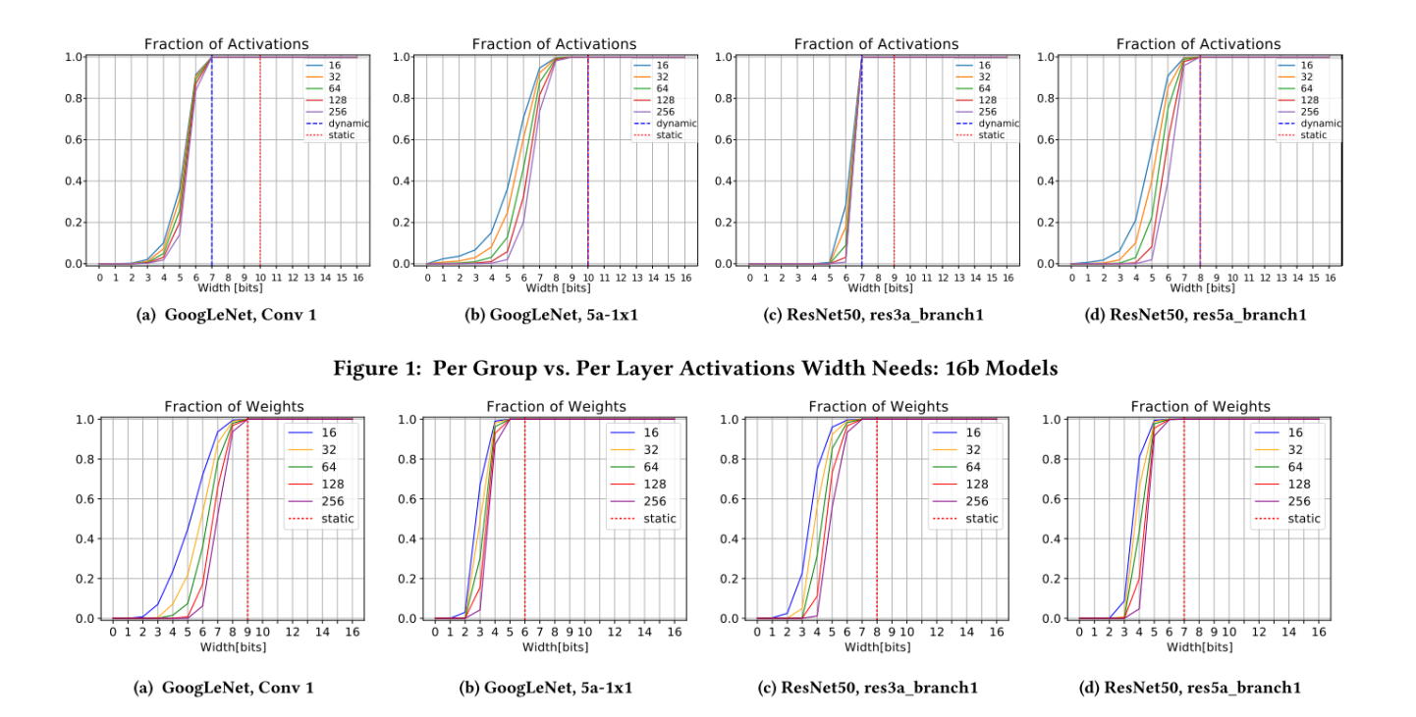
Data width needed

Slide 4
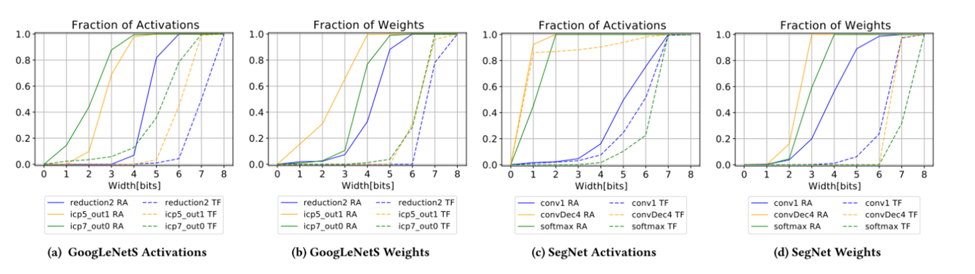
Data width needed
Compression for different quantization methods

Slide 5
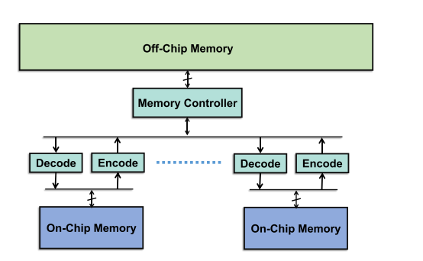
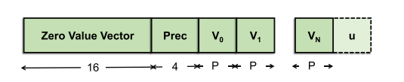
Off-chip compression scheme

Slide 6
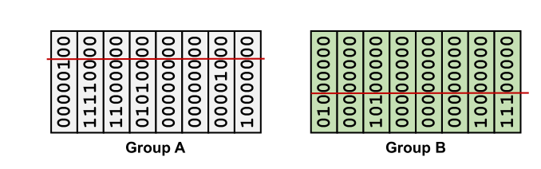
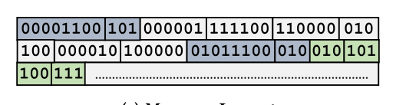
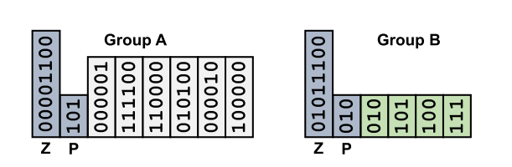
Off-chip compression scheme

Slide 7
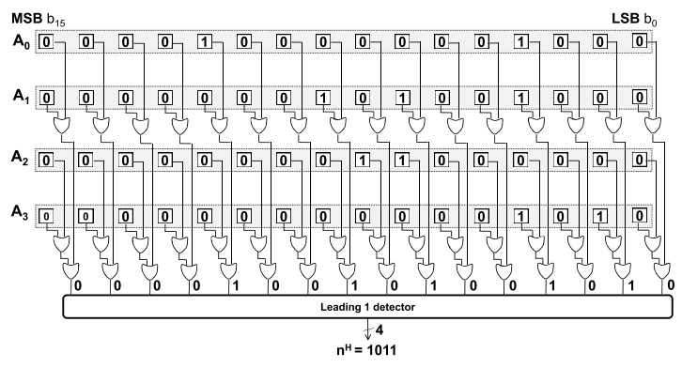
Detecting per group widths for activations
Trims the unnecessary prefix bits by detecting the most significant bit position needed to represent all values within the group.

Slide 8
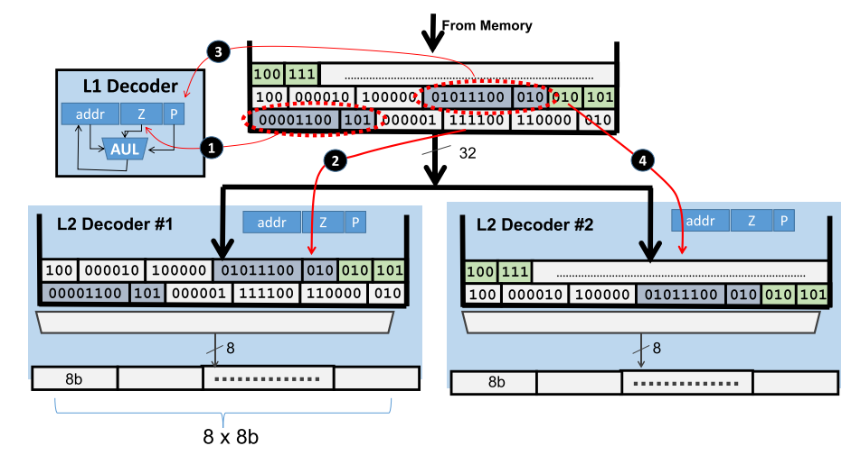
Decompression
Using multiple decoders organized in a two level hierarchy.

Slide 9
Compression
The output activations of each layer are assembled in groups in each bank, and are encoded accordingly using the width detected by the hardware at page 7.

Slide 10
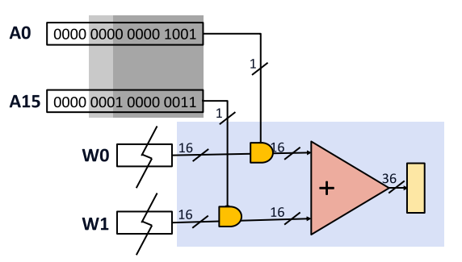
Reduction execution time
From Stripes to SStripes
The SIP unit multiplies and accumulates 16(activation, weight) pairs.
The SIP unit processes the activations one bit at time. Any data width up to 16b is supported.

Slide 11
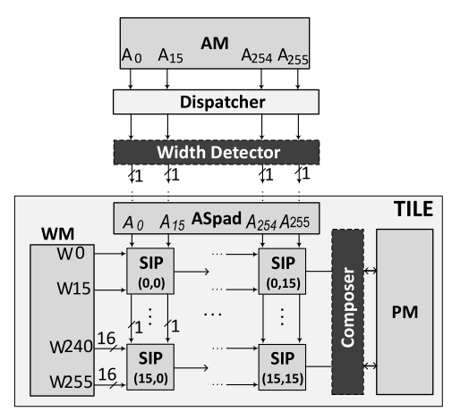
Reduction execution time
From stripes to sstripes
Each tile processes 16 filters and 16 weights per filter. The SIPs along the same row process different windows of the same output channel; And the SIPs along the same column process the same window of different output channels.
The width detector inspects the activation group and generates EOG signal to terminate computation in corresponding SIPs.
The composer allows the results of two SIPs adjacent along the same column.

Slide 12
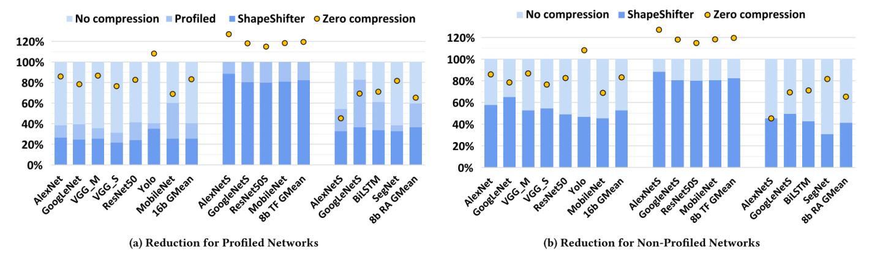
Evaluation
Compression rate

Slide 13
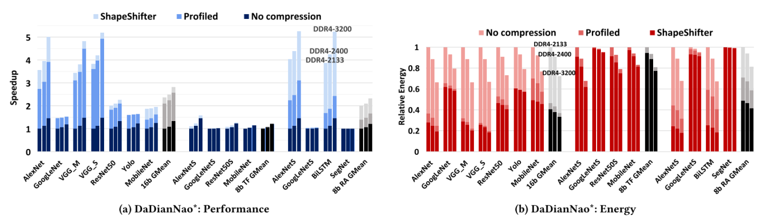
Evaluation
Using ShapeShifter in DaDiannao

Slide 14
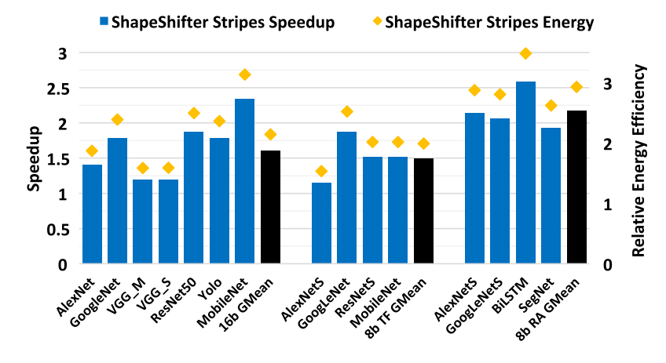
Evaluation
Stripes vs SStripes

Slide 15
Thank you!

